Slide 1
EE-215 Lecture No 04
Electronic Devices & Circuits
Text Book: Chapter 03 (Sedra/Smith 6th Ed)
Semiconductors
3.1 Intrinsic Semiconductors
3.2 Doped Semiconductors
3.3 Current Flow in Semiconductors
3.4 The p-n Junction with Open-Circuit Terminals
Instructor: Shakeel Alvi
Class: Spring 2022
Electrical Engineering Department

Slide 2
Introduction
This book initially adopts top down approach
Starts with emphasis on amplifiers in electronic equipment
Then operational amplifier is discussed as a block, followed by its different applications
From chapter No 3, the authors starts from basics of semiconductors

Slide 3
Conductivity & Current
Thus each material will have different conductivity
Electric current is rate of flow of electric charge or the amount of charge flowing through a particular area in unit time
Electrical conductivity is the measure of the amount of electrical current a material can carry or it's ability to carry a current. Electrical conductivity is also known as specific conductance.
Conductivity is an intrinsic property of a material.

Slide 4
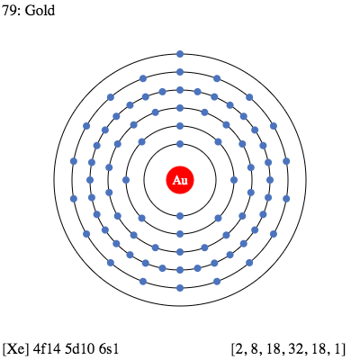
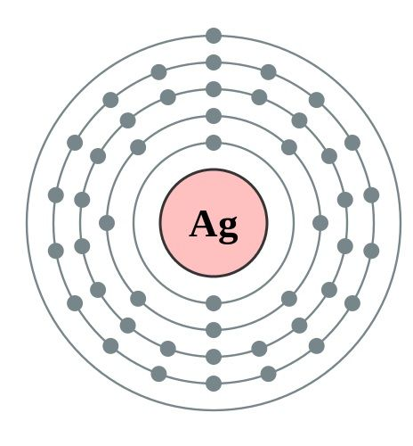
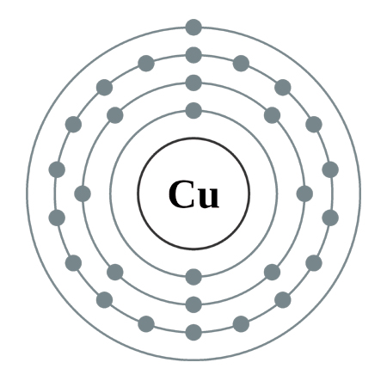
Introduction
Semiconductors, Conductors and Insulators
Conductors
Material that easily conducts electrical current.
The best conductors are single-element material (copper, silver, gold, aluminum)
One valence electron very loosely bound to the atom- free electron
copper
silver
gold

Slide 5
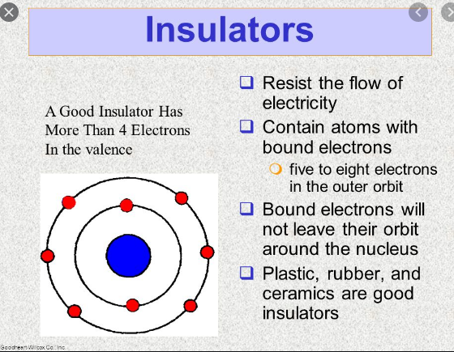

Slide 6
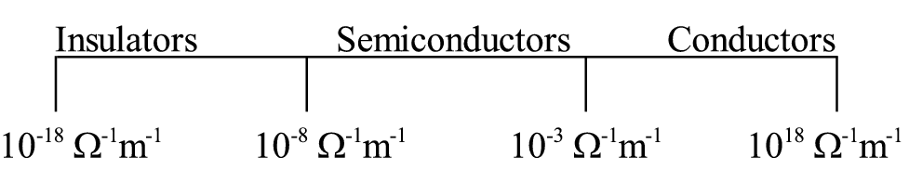
Semiconductors
Semiconductors are materials whose electrical properties lie between Conductors and Insulators.
Ex : Silicon and Germanium: in element form
: Gallium Arsenide in compound form
Difference in conductivity

Slide 7
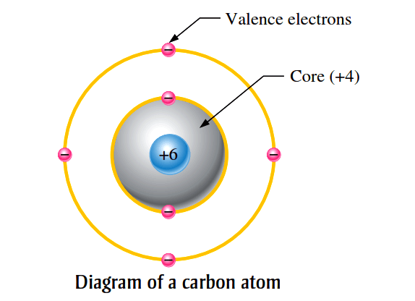
Introduction
Semiconductors
in its pure (intrinsic) state is neither a good conductor nor a good insulator
most commonly use semiconductor ; silicon(Si), germanium(Ge), and carbon(C).
contains four valence electrons

Slide 8
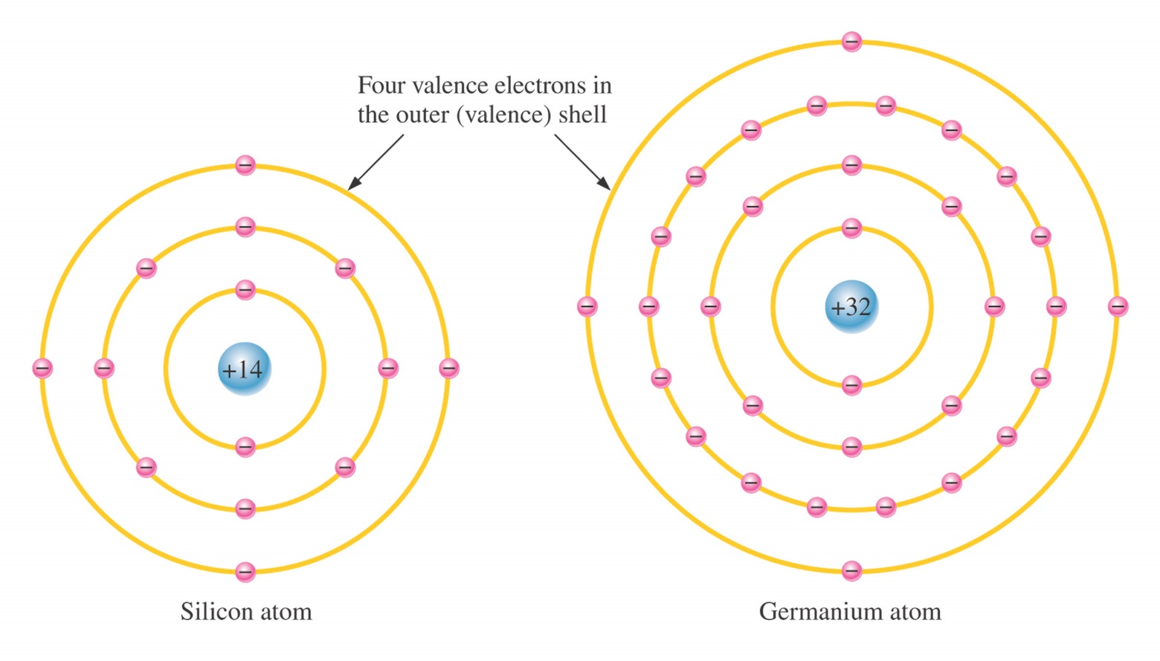
Introduction
Atomic Structures
Valence Electrons
Electrons with the highest energy levels exist in the outermost shell.
Electron in the valence shell called valence electrons.
Notes:
Figure 1-1 Bohr Model

Slide 9
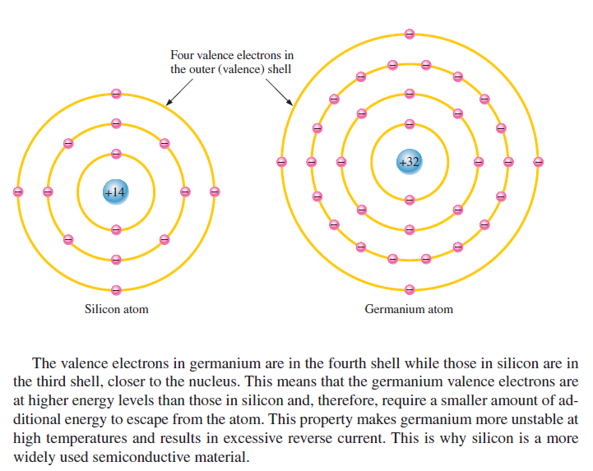
Why Silicon is more widely used then Germanium

Slide 10
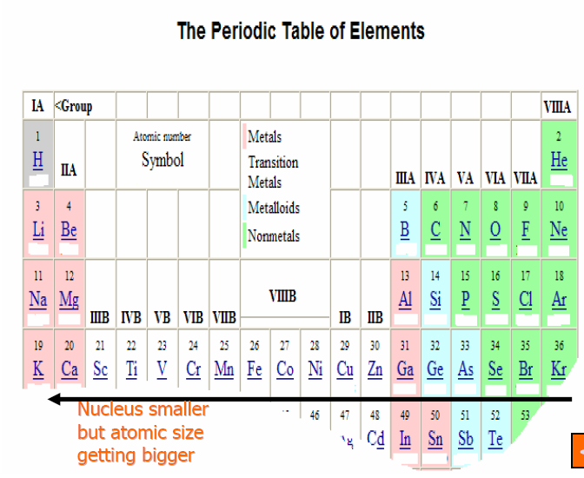
Introduction
Semiconductors, Conductors and Insulators

Slide 11
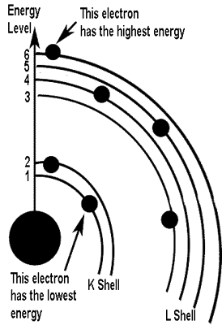
Orbiting electrons contain energy and are confined to definite energy levels. The various shells in an atom represent these levels. Therefore, to move an electron from a lower shell to a higher shell a certain amount of energy is required. This energy can be in the form of electric fields, heat, light, and even bombardment by other particles
If a sufficient amount of energy is absorbed by an electron, it is possible for that electron to be completely removed from the influence of the atom. This is called IONIZATION. When an atom loses electrons or gains electrons in this process of electron exchange, it is said to be ionized
. An atom having more than its normal amount of electrons acquires a negative charge, and is called a NEGATIVE ION.
The atom that gives up some of its normal electrons is left with fewer negative charges than positive charges and is called a POSITIVE ION.

Slide 12
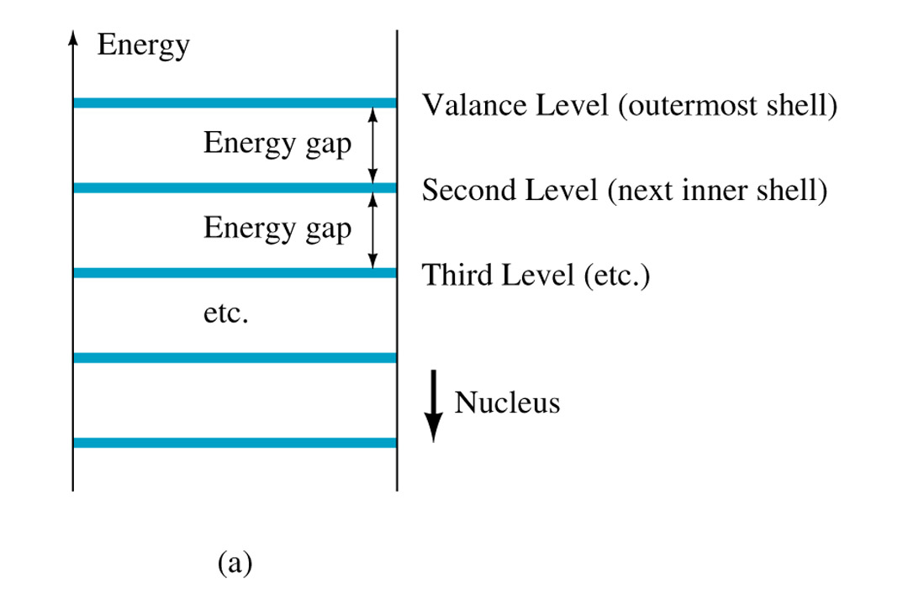
Semiconductors, Conductors and Insulators
Energy Bands

Slide 13
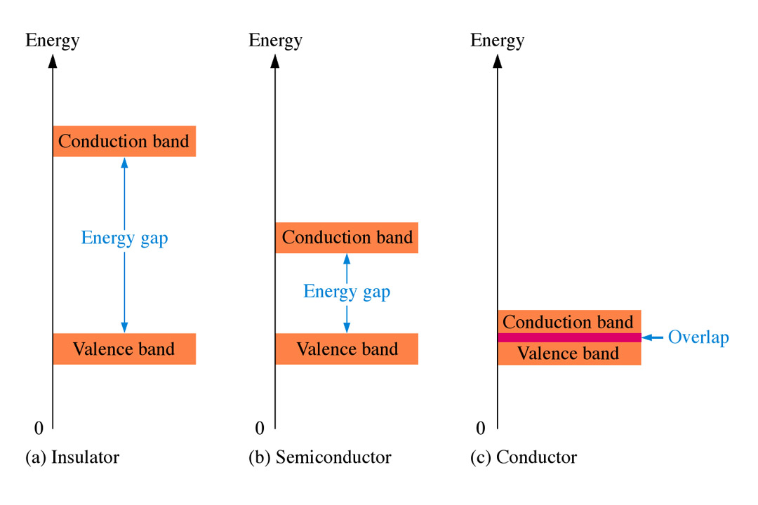
Semiconductors, Conductors and Insulators
Energy Bands
Energy gap-the difference between the energy levels of any two orbital shells
Band-another name for an orbital shell (valence shell=valence band)
Conduction band –the band outside the valence shell

Slide 14
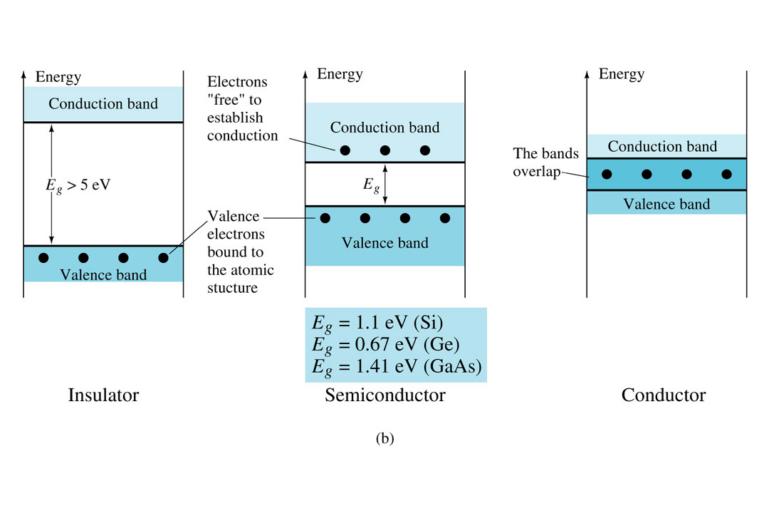
Semiconductors, Conductors and Insulators
at room temperature 25°
eV (electron volt) – the energy absorbed by an electron when it is subjected to a 1V difference of potential

Slide 15
Bonding
Ionic bonding.
Covalent bonding.
Metallic bonding

Slide 16
Ionic bond is much stronger than covalent bond because it involves complete transfer of electrons because of which there is formation of cation and anion and there exist huge electrostatic forces of attraction. They also have high melting and boiling point which proves that the ionic bond is very strong.

Slide 17
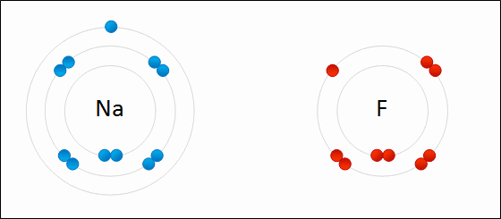
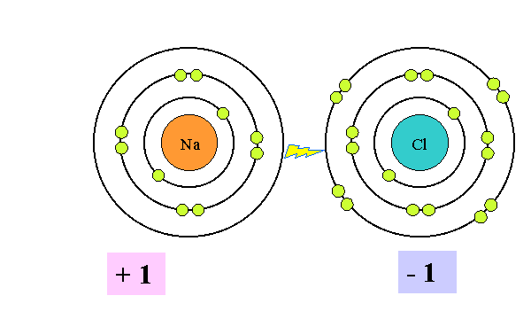
Ionic Bonding
Sodium
Fluorine

Slide 18
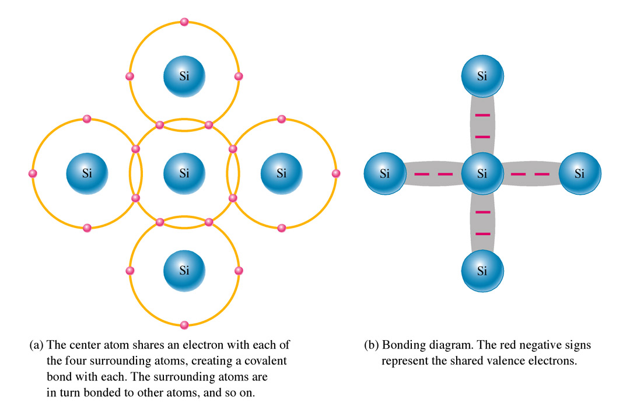
1-3 Covalent Bonding
Covalent Bonding
Covalent bonding – holding atoms together by sharing valence electrons
sharing of valence electron
produce the covalent bond
To form Si crystal
Notes:
Fig. 1-8 Covalent bonding

Slide 19
Covalent Bonding
The result of the bonding:
The atom are held together forming a solid substrate
The atoms are all electrically stable, because their valence shells are complete
The complete valence shells cause the silicon to act as an insulator-intrinsic (pure) silicon is a very poor conductor
Notes:
Fig. 1-8 Covalent bonding

Slide 20
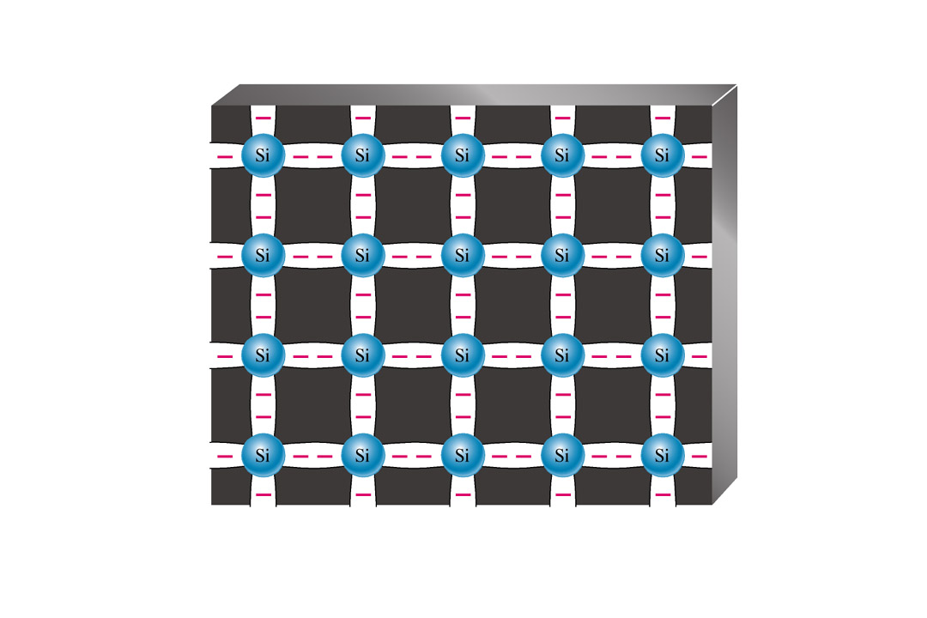
Covalent Bonding
Certain atoms will combine in this way to form a crystal structure. Silicon and Germanium atoms combine in this way in their intrinsic or pure state.
Covalent bonds in a 3-D silicon crystal
Notes:
Fig. 1-9 Intrinsic Silicon

Slide 21
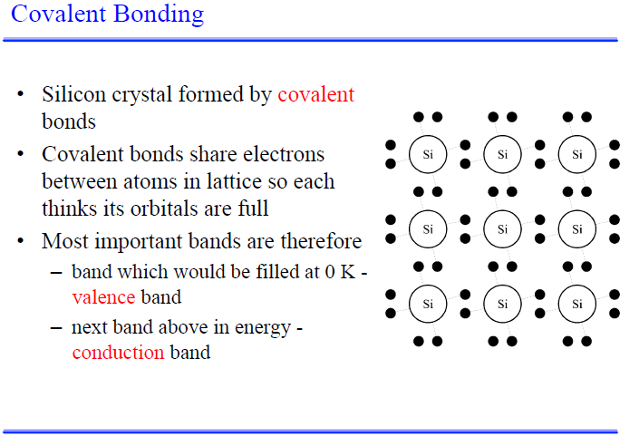

Slide 22
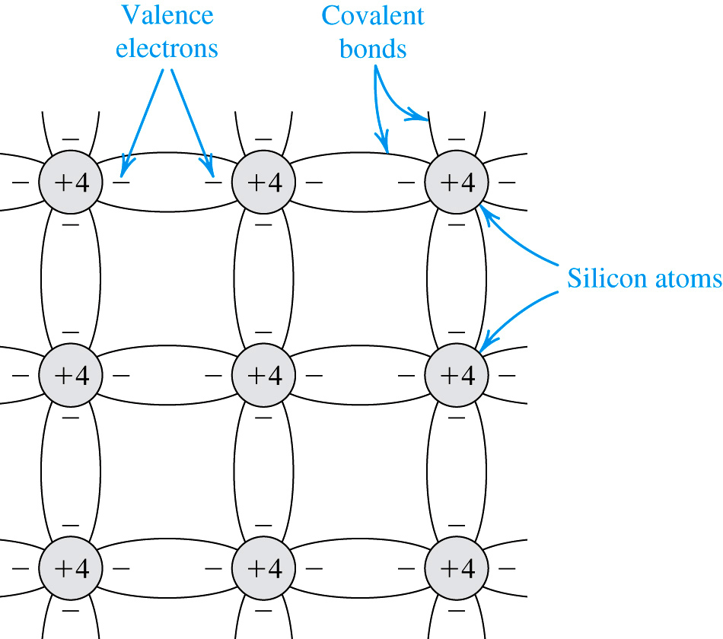
Intrinsic(Pure) Semiconductors
Two-dimensional representation of the silicon crystal
The circles represent the inner core of silicon atoms, with +4 indicating its positive charge of +4q
The +ve charge in the inner core is neutralized by the charge of the four valence electrons
Covalent bonds are formed by sharing of the valence electrons
At 0 K,(i.e. -273 C) all bonds are intact and no free electrons are available for current conduction

Slide 23
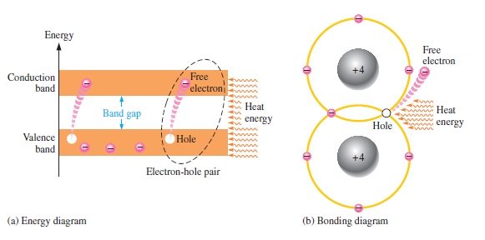
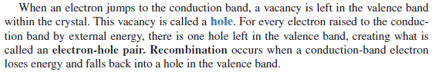
An Intrinsic (Pure) Silicon crystal at room temperature has sufficient thermal energy for some valance electrons to jump the gap from valance band into conduction band, becoming free electrons. Free electrons are also called conduction electrons

Slide 24
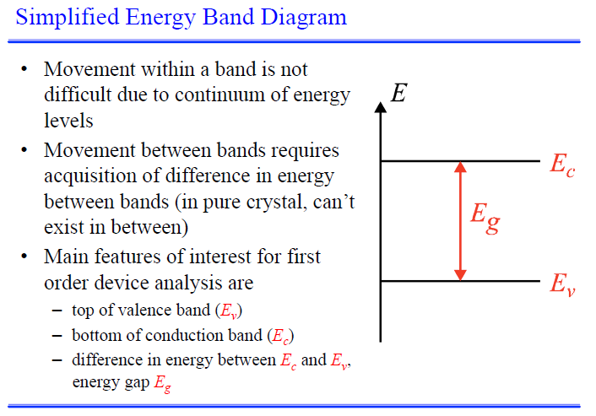

Slide 25
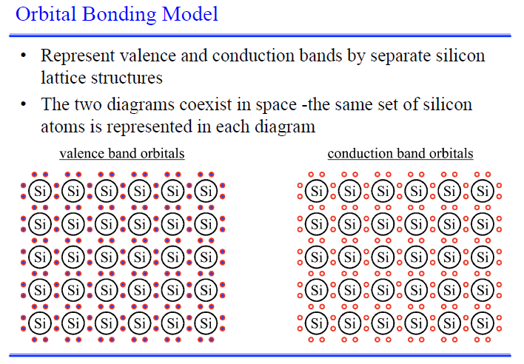

Slide 26
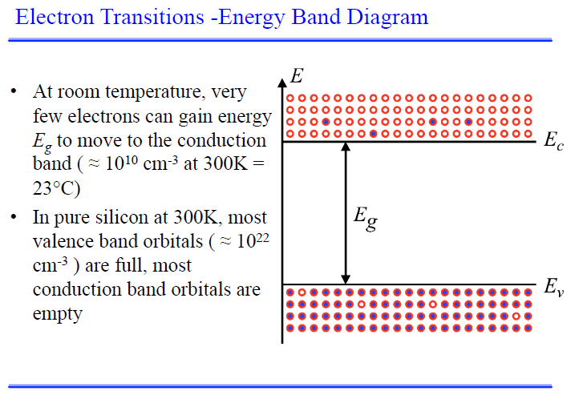

Slide 27
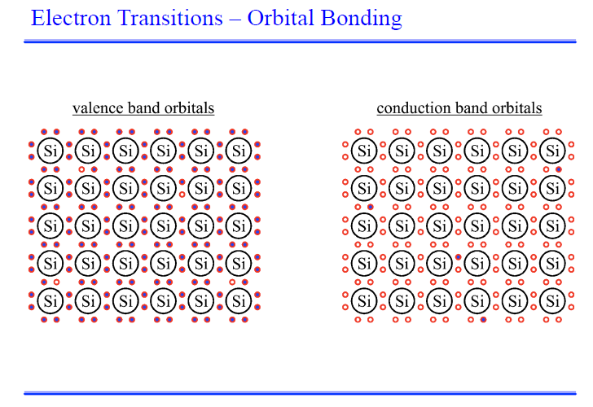

Slide 28
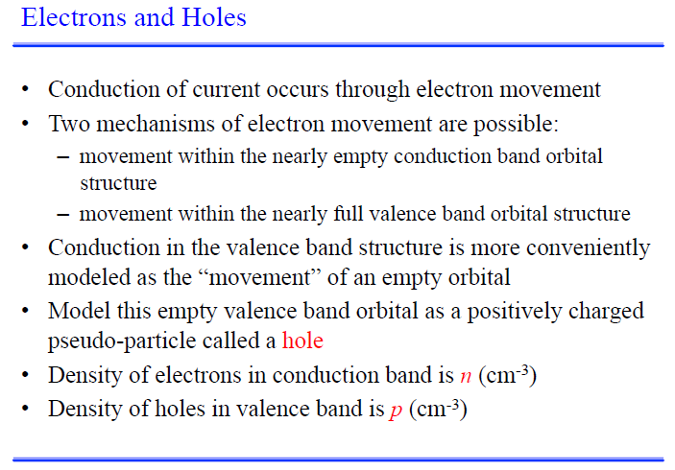

Slide 29
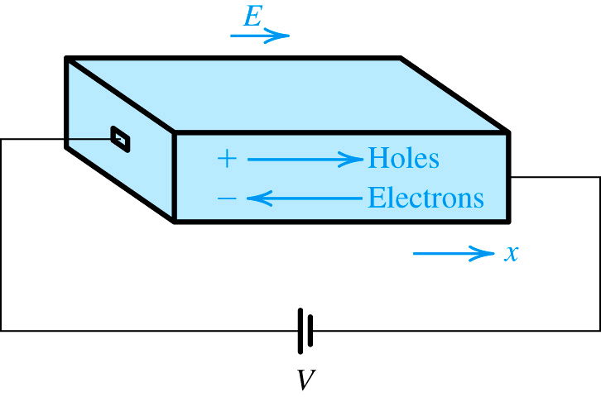
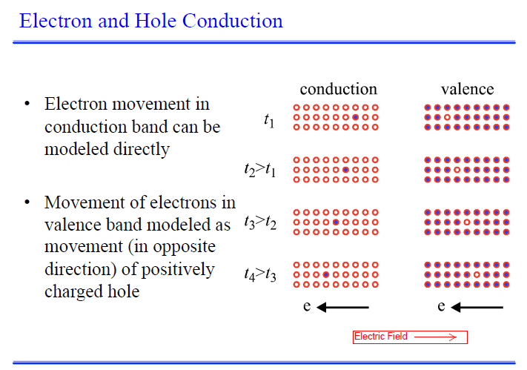

Slide 30
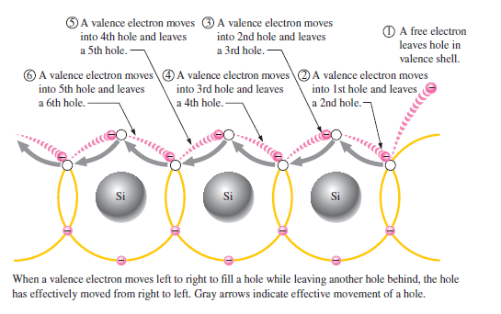

Slide 31
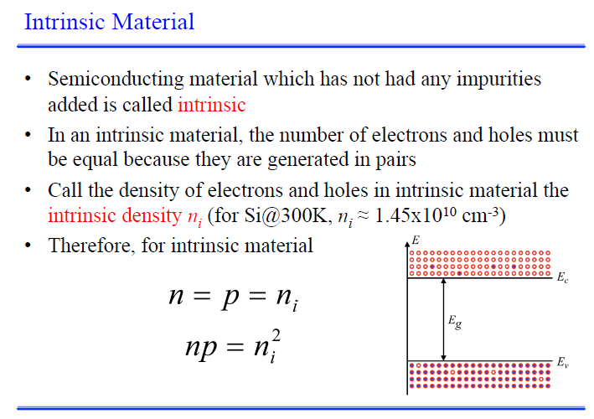

Slide 32
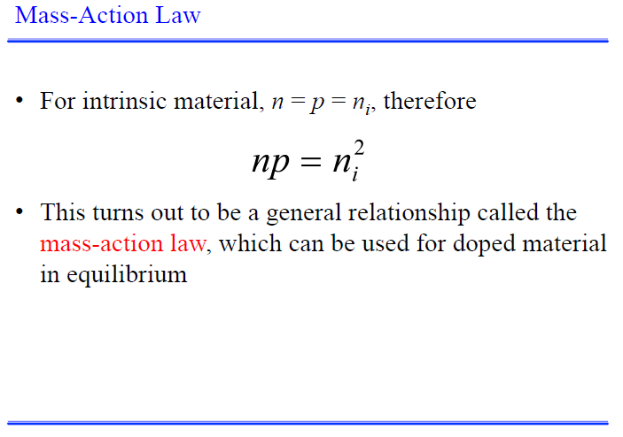

Slide 33
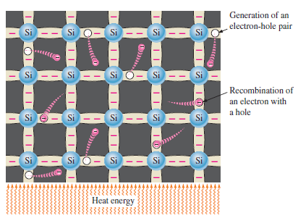
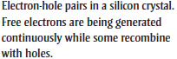
Thermal Generation and re-combination

Slide 34
Free Charge Carrier Density
In thermal equilibrium: thermal generation = recombination
Concentration of free electrons = Concentration of holes
n = p = n_{i} (n_{i} number of free electrons and holes)
{Semiconductor physics}
B is material dependent constant; for Silicon it is equal to 7.3 x10¹⁵/cm³K
E_{g}, (bandgap energy) is the energy required to break off an electron from its covalent bond
For Silicon E_{g} is 1.12eV
k is Boltzmann’s constant and equal to 8.62 x 10⁻⁵ eV/K
T is temperature in Kelvin

Slide 35
Free Electron Density at a Given Temperature
Although this number seems large , to place it into context note that silicon has 5 x 10 ²² atoms/cm³
Thus at room temperature only one in about 5 x 10¹² atoms is ionized and contributing a free electron and a hole
It is useful for future purpose' to express the product of the hole and free-electron concentration as

Slide 36
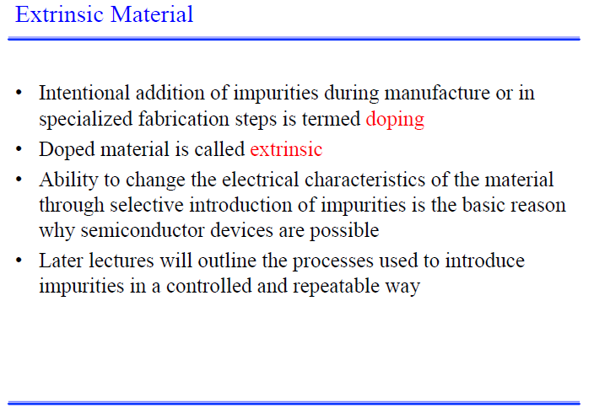

Slide 37
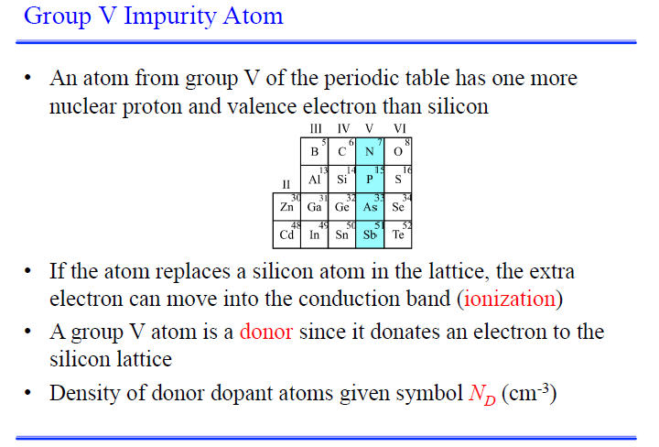

Slide 38
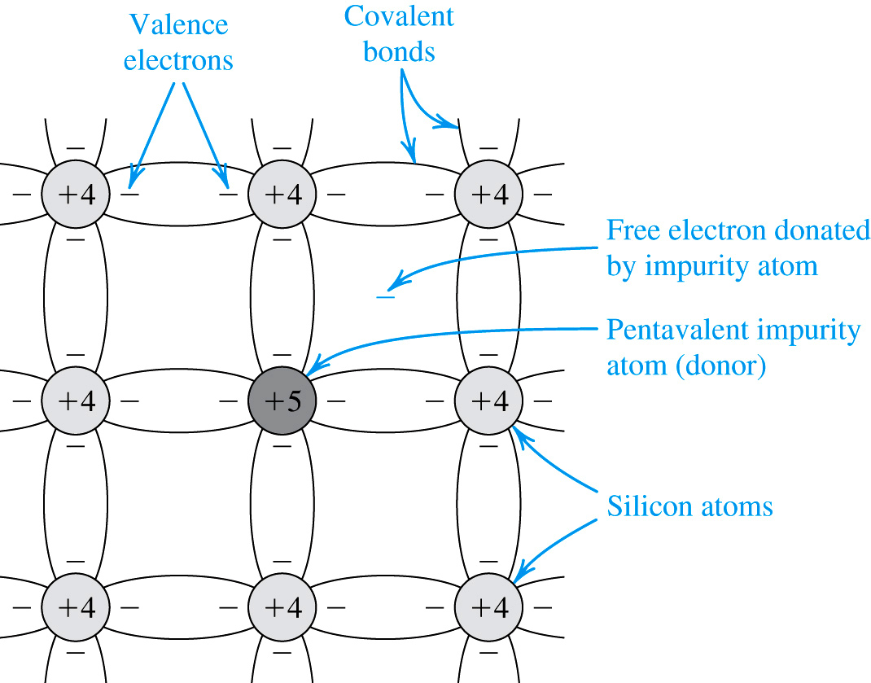
Doping (N type)
Impurity atoms are introduced into Si crystal to change its electrical properties.
If P(phosphorous) atoms are injected into the Si crystal, it has more free electrons, and becomes type N semiconductor
Note: The product of electron and hole densities is ALWAYS equal to the square of intrinsic electron density regardless of doping levels.

Slide 39
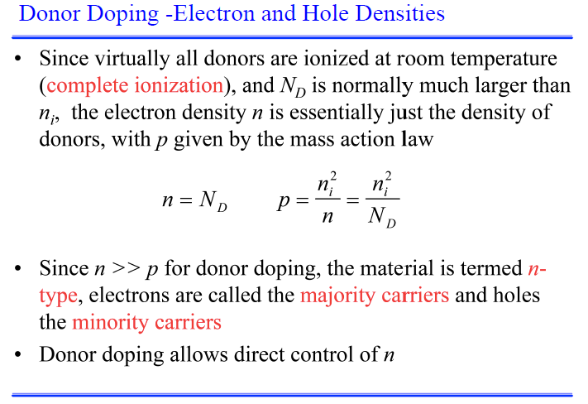

Slide 40
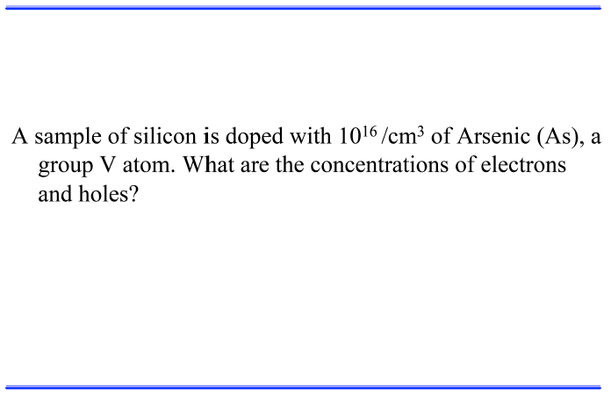
Example No 1

Slide 41
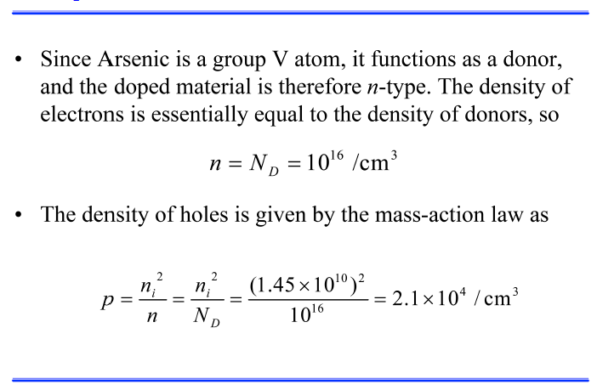
Solution No 1

Slide 42
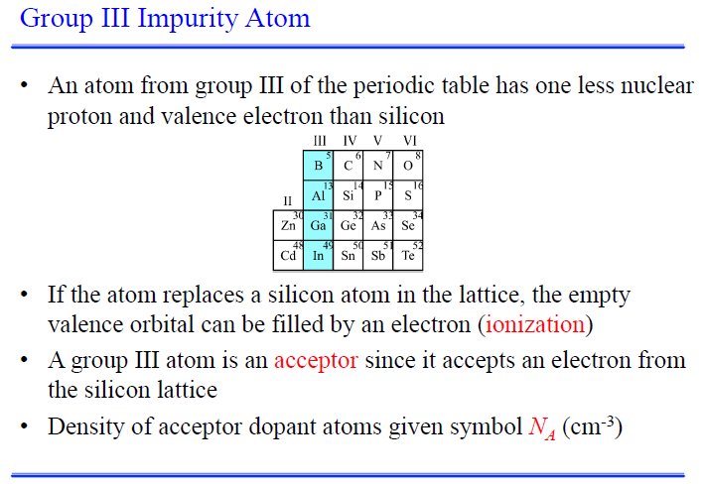

Slide 43
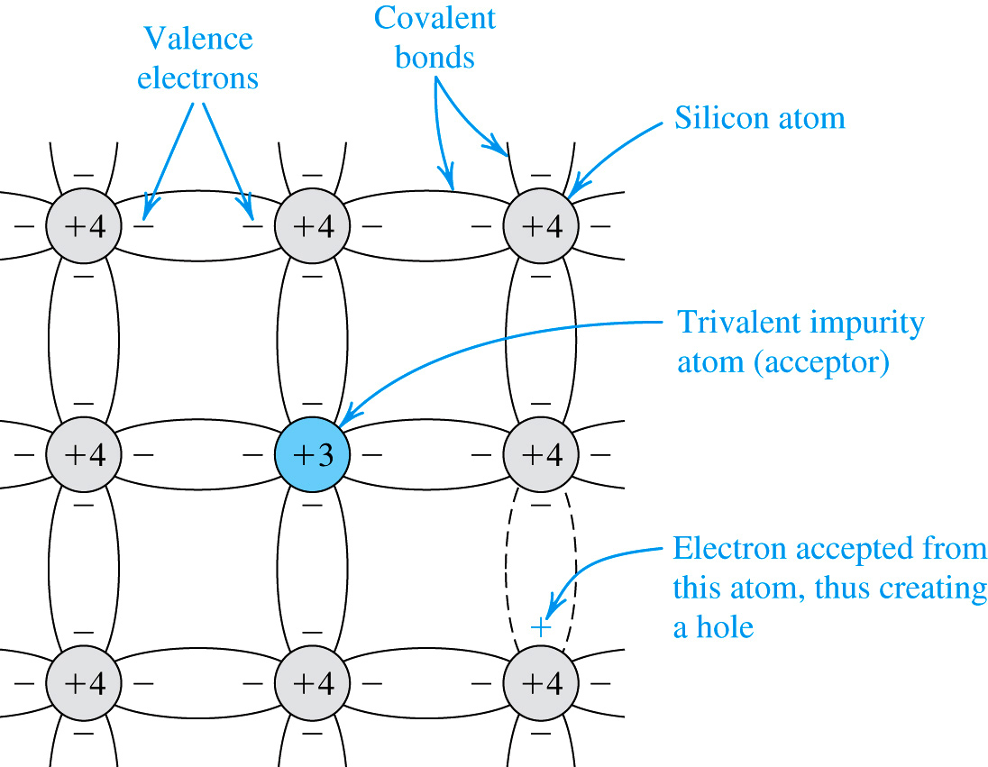
Doping (P type)
If Si is doped with B (boron), then it has more holes, or becomes type P semiconductor
Note: The product of electron and hole densities is ALWAYS equal to the square of intrinsic electron density regardless of doping levels.

Slide 44
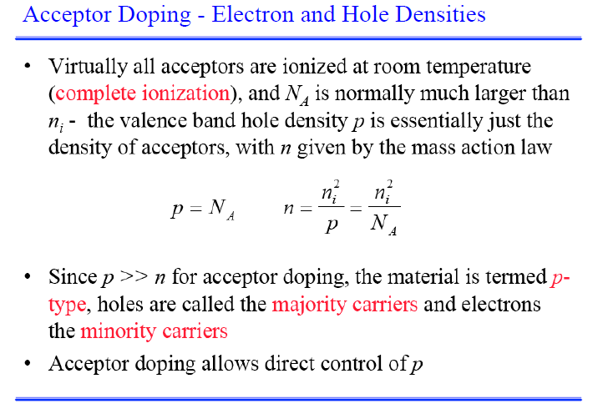

Slide 45
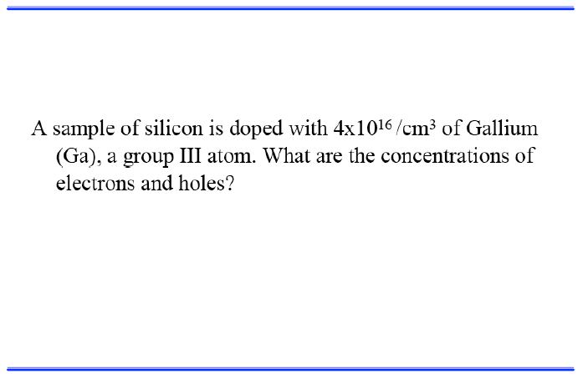
Example No 2
Gallium Doping

Slide 46
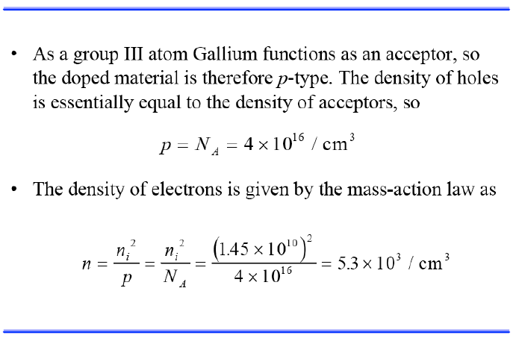
Solution No 2

Slide 47
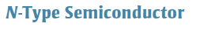
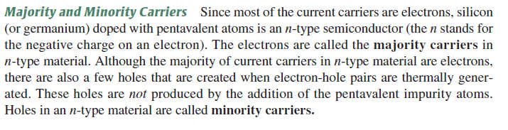
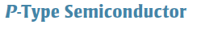
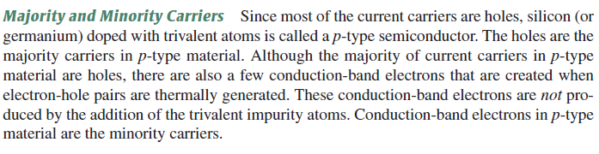

Slide 48
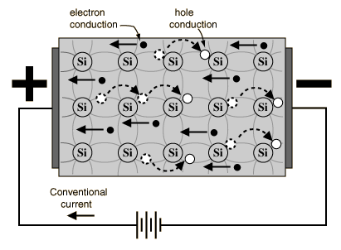
Semiconductor Current
The current which will flow in an intrinsic semiconductor consists of both electron and hole current. That is, the electrons which have been freed from their lattice positions into the conduction band can move through the material.
In addition, other electrons can hop between lattice positions to fill the vacancies left by the freed electrons. This additional mechanism is called hole conduction because it is as if the holes are migrating across the material in the direction opposite to the free electron movement

Slide 49
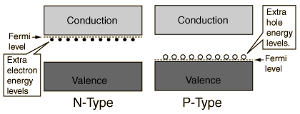
The application of band theory to n-type and p-type semiconductors shows that extra levels have been added by the impurities. In n-type material there are electron energy levels near the top of the band gap so that they can be easily excited into the conduction band. In p-type material, extra holes in the band gap allow excitation of valence band electrons, leaving mobile holes in the valence band.

Slide 50


Slide 51
Electron and Hole Densities
In p-type material holes are majority and electrons are minority carriers
In n-type material electrons are majority and holes are minority carriers
If N_{A} is number of acceptor atoms and N_{D} number od donor atoms
Majority Carriers :
Minority Carriers :
In p-type material
Majority Carriers :
Minority Carriers :
In n-type material

Slide 52
Example 3.2
Consider an n-type silicon for which the dopant concentration N_{D} = 10¹⁷/cm³. Find the electron and hole concentration at T = 300 K.
Comparison of n_{n}, n_{i} and p_{n}

Slide 53
Current Flow in Semiconductors
Two different mechanism for current flow are:
Drift and Diffusion

Slide 54
The Drift Current
The process in which charge particles move because of an electric field is called drift.
An electric field E causes the holes to drift in the direction of E and the free electrons to drift in the opposite direction.
Both the hole and electron drift currents are shown wrt the direction of E.
Charge particles will move at a velocity that is proportional to the electric field.
µ_{p} and µ_{n} are respectively hole and electron mobility

Slide 55
The Drift Current
For intrinsic silicon
µ_{p} = 480 cm²/V.s and
µ_{n} = 1350 cm²/V.s
The electrons move with greater ease through the silicon crystal than the holes

Slide 56
The Drift Current

Slide 57
The Drift Current
A form of Ohm’s law.
May be written as:
The conductivity σ is given by
And the resistivity ρ is given by

Slide 58

The Diffusion Current
Charge particles move from a region of high concentration to a region of low concentration
Holes are injected into the silicon bar shown in the figure, thus creating the hole concentration profile along the x axis
The holes diffuse in the positive direction of x and give rise to a hole-diffusion current in the same direction
The current density is proportional to the slope concentration profile
Diffusion constant

Slide 59

The Diffusion Current
In case of electron diffusion the current density is:
Electrons diffuse in the x direction, giving rise to an electron current in the negative -x direction.
Typical values for D_{p} and D_{n} in intrinsic silicon are:
D_{p} = 12 cm²/s and D_{n} = 35 cm²/s

Slide 60

Einstein's Relation
At room temperature (i.e. 300 K)
V_{T} = 25.9 mv
While the physics behind drift and diffusion currents are totally different, Einstein’s relation provides link between the two.

Slide 62
First we will calculate the
Values of n and p

Slide 66
Exercise

Slide 68
EE-215 Lecture
Electronic Devices & Circuits
Text Book: Chapter 03 (Sedra/Smith 6th Ed)
Semiconductors
3.4 The pn Junction with Open-Circuit Terminals
3.5 The pn Junction with an Applied Voltage
Instructor: Dr. Shakeel Alvi
Class: Spring 2022
Electrical Engineering Department

Slide 69

The PN Junction
Simplified physical structure of the pn junction
As the pn junction implements the junction diode, its terminals are labeled anode and cathode

Slide 70

PN Junction with open Circuit Terminals

Slide 71
PN Junction with open Circuit Terminals
I_{D} is the diffusion current
I_{S} is the drift current
In the depletion region holes and electron recombine, thus no free charge carrier
Positive charge on the N-side and negative on the P-side of the junction cause a barrier voltage across the junction

Slide 72
PN Junction with open Circuit Terminals
The drift current I_{S} is due to minority carrier
Electrons in the p-material at the edge of depletion region are swept into the n-side under the effect of electric field in the depletion region
Holes from n-material are swept into the p-side
Under the equilibrium condition I_{D} = I_{S}
The barrier voltage V_{o} is given by:

Slide 73
PN Junction with open Circuit Terminals
For silicon at room temperature, V_{o} is in the range of 0.6 to 0.9 volts
Dependence on temperature ???

Slide 74

Width of, and Charge Stored in the Depletion Region
The depletion layer extends in both the p and n materials
Equal amounts of charge exist on both sides
Width of depletion layer on either side depends on doping level. It will extend deeper into the lightly doped material.
In the figure n-type material is lightly doped as compared to p-type
(N_{A} > N_{D})

Slide 75
Width of, and Charge Stored in the Depletion Region

Slide 76
Width of, and Charge Stored in the Depletion Region

Slide 77

PN Junction with an Applied Voltage

Slide 78

PN Junction with an Applied Voltage
Current in the external circuit is : I = I_{D} - I_{S}

Slide 79

PN Junction Current-Voltage Relationship
For negative V with a magnitude of a few times V_{T} the exponential term becomes zero and the current across the junction becomes negative and constant. This constant current is I_{S}
The reverse current saturates at –I_{S}, therefore is given the name saturation current
“I_{S}” is directly proportional to junction’s cross-sectional area, thus is also known as junction scale current

Slide 80
PN Junction Current-Voltage Relationship
This is the diode equation
The current and voltage relationship of a PN junction is exponential in forward bias region, and relatively constant in reverse bias region.

Slide 81

PN Junction Reverse Breakdown
The reverse current is very small till V < V_{Z}
As V reaches V_{Z} , the reverse current sharply increases. This phenomenon is known as junction breakdown
The phenomenon is non-destructive till the breakdown current is limited to a safe value
The safe value of current depends on the power dissipation capacity of the junction
Possible mechanism for junction breakdown : the zener effect and the avalanche effect

Slide 82

Zener vs. Avalanche Breakdown
Zener breakdown is a result of the large electric field inside the depletion region that breaks electrons or holes off their covalent bonds.
Avalanche breakdown is a result of electrons or holes colliding with the fixed ions inside the depletion region.

Slide 83

PN Junction Capacitance
The PN junction can be viewed as a capacitor. By varying V_{R}, the depletion width changes, changing its capacitance value; therefore, the PN junction is actually a voltage-dependent capacitor.

Slide 84


PN Junction Capacitance

Slide 85

Voltage-Controlled Oscillator
A very important application of a reverse-biased PN junction is VCO, in which an LC circuit is used in an oscillator.
By changing V_{R}, we can change C, which also changes the oscillation frequency.

Slide 86


Slide 87


